Slide 1
Dyscalculia
Module 4: Inclusiveness in all areas of education and training
Assoc. Prof. Dr. Oguzhan KIRDÖK
Cukurova University
Change Your Perspective: It´s Just Dyscalculia
Reference Number: 2022-1-TR01-KA220-SCH-000088738
Duration: 31.12.2022-30.12.2024 (24 months)
School Education ERASMUS+
KA220-SCH-Cooperation partnerschips in school education

Slide 2
Module 4: Inclusiveness in all areas of education and training
Aim of Module
Learning Outcomes
Activity: Less-More, Big-Small Awareness
Activity: Completion activity
Activity: Development of Attention
Activity: Simple Addition Activity
Activity: Number Puzzle Activity
Activity: Square Scribble Activity
Activity: Finding the Right Direction Activity

Slide 3
Module 4: Inclusiveness in all areas of education and training
1. Aim of Module
Ensuring the social integration of dyscalculic students and improving overall education quality require strategies rooted in inclusivity.
This involves fostering a supportive social environment, implementing inclusive practices in lesson plans, and promoting collaboration among teachers, support staff, and parents.
These efforts collectively contribute to a more inclusive and enriching classroom experience for all students

Slide 4
Module 4: Inclusiveness in all areas of education and training
2. Learning Outcomes
Knowledge:
Understanding of the principles and importance of inclusiveness in all aspects of education and training.
Knowledge of the challenges faced by dyscalculic students in terms of social integration and classroom adaptation.
Awareness of the factors that contribute to the quality of school education.
Familiarity with inclusive practices in education and their role in enhancing educational quality.

Slide 5
Module 4: Inclusiveness in all areas of education and training
2. Learning Outcomes
Social Integration Skills: Proficiency in facilitating the social integration of dyscalculic students and helping them adapt to the classroom environment.
Strategic Development Skills: The ability to develop strategies aimed at improving the overall quality of school education, with a focus on inclusiveness.
Inclusive Education Strategy Skills: Competence in designing and implementing strategies that promote inclusive practices and enhance educational quality.
Skills:

Slide 6
Module 4: Inclusiveness in all areas of education and training
2. Learning Outcomes
Competences:
Inclusive Education Competence: The proficiency to ensure that education and training are inclusive in all areas, fostering an environment where every student, including dyscalculic students, feels welcome and supported.

Slide 7
Module 4: Inclusiveness in all areas of education and training
3. Activity: Less-More, Big-Small Awareness
Learning Time: | 20-30 minutes
Content: | Students with dyscalculia can often confuse the concepts of size and smallness of objects and the concepts of more and less. This confusion can also be seen in students who have just started primary school. Especially in the first years of primary school, visual activities aimed at comparison as a comprehensive study will enable students to understand the differences between big and small and more or less. For this purpose, images and similar ones in Form-1 and Form-2 can be used. These visuals are reproduced according to the number of students and distributed to all students. You are instructed to mark the larger number. In addition, the permanence of the intended gains can be increased by the student coloring in a number of boxes that represent the value of the number, as in the visual in Form-2.

Slide 8
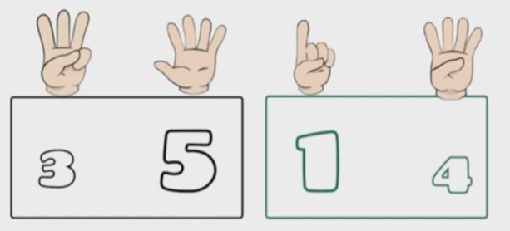
Module 4: Inclusiveness in all areas of education and training
3. Activity: Less-More, Big-Small Awareness
FORM 1

Slide 9

Module 4: Inclusiveness in all areas of education and training
3. Activity: Less-More, Big-Small Awareness
FORM 2

Slide 10
Module 4: Inclusiveness in all areas of education and training
3. Activity: Less-More, Big-Small Awareness
Additional Learning Sources:
Elkaan, G. (2022). Examination of basic number proficiency and visual perception skills of students with good and poor mathematics performance (Master's thesis, Hasan Kalyoncu University).
https://www.youtube.com/watch?v=cshehFbVPV0

Slide 11
Module 4: Inclusiveness in all areas of education and training
4. Activity: Completion activity
Learning Time: | 15-20 minutes
Content: | It is very important for children with dyscalculia to understand the relationship between the amount of objects and numbers. These visuals are reproduced according to the number of students and distributed to all students. In a table consisting of a certain number of boxes, as in the picture in Form-3, a certain number of boxes are colored and then this table is shown to the student once and removed. Afterwards, the teaching of basic numbers, addition and subtraction can be achieved through gamification by asking the student questions such as how many boxes are in the table in total, how many boxes are colored in the table, how many more boxes need to be colored in order for all the total boxes to be colored.

Slide 12
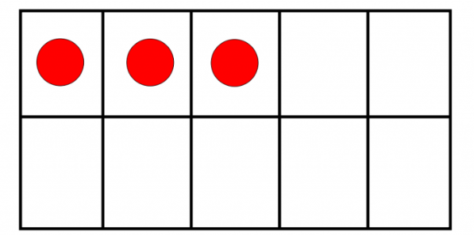
Module 4: Inclusiveness in all areas of education and training
4. Activity: Completion activity
FORM 3

Slide 13
Module 4: Inclusiveness in all areas of education and training
4. Activity: Completion activity
Additional Learning Sources:
Avci, A. (2020). Evaluation of teaching practices for primary school students with mathematics learning difficulties (Master's thesis, Institute of Educational Sciences).

Slide 14
Module 4: Inclusiveness in all areas of education and training
5. Activity: Development of Attention
Learning Time: | 15-20 minutes
Content: | Distraction and focus are important problem areas in children with dyscalculia. Activities aimed at gathering students' focus and attention will be effective. By preparing study cards similar to the examples in Form-4 and Form-5, it is aimed to improve the attention skills of students with dyscalculia. Thanks to these types of activities, students make progress in distinguishing letters and numbers that are so similar that they can be confused with each other. In Form-4, students are asked to find how many numbers 5 are in the visual and circle them. Finding time is given as 1 minute. Even if a minute has passed, all students are asked to find the fives. Students who find fives missing or wrong are asked to notice the difference between 5 and S. In Form-5, students are asked to find the numbers 6 and circle them. When students confuse the numbers 9,6 and G, they are encouraged to notice the difference.

Slide 15
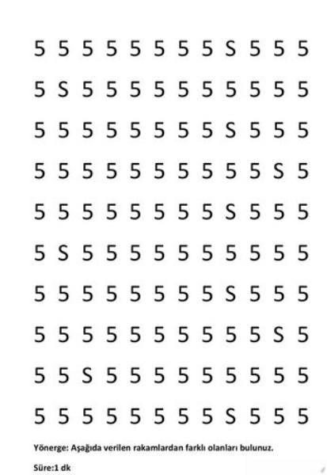
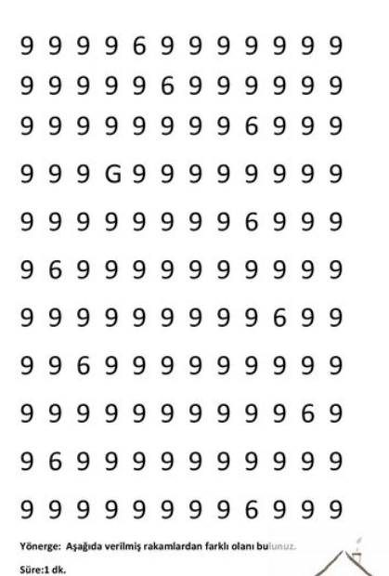
Module 4: Inclusiveness in all areas of education and training
5. Activity: Development of Attention
FORM 4
FORM 5

Slide 16
Module 4: Inclusiveness in all areas of education and training
5. Activity: Development of Attention
Additional Learning Sources:
Avci, A. (2020). Evaluation of teaching practices for primary school students with mathematics learning difficulties (Master's thesis, Institute of Educational Sciences).
https://www.youtube.com/watch?v=1W17IfnBFDc

Slide 17
Module 4: Inclusiveness in all areas of education and training
6. Activity: Simple Addition Activity
Learning Time: | 15-20 minutes
Content: | Concretization of mathematical concepts is an auxiliary method in teaching children with dyscalculia. For this purpose, it is aimed to concretize the operation with fingers while doing addition, as in the activity examples in Form-7. The visuals in Form-6 are given to the students and the students are asked to write the number of fingers of the hands in the visual in the boxes and make the sum using numbers and hand drawings. Then, the teacher shows the number of fingers on their own hands to the students and asks them to write these numbers in their notebooks. The total score is again displayed with numbers and finger drawings. In the rest of Form-6, they are asked to write the point total numbers in the boxes.

Slide 18
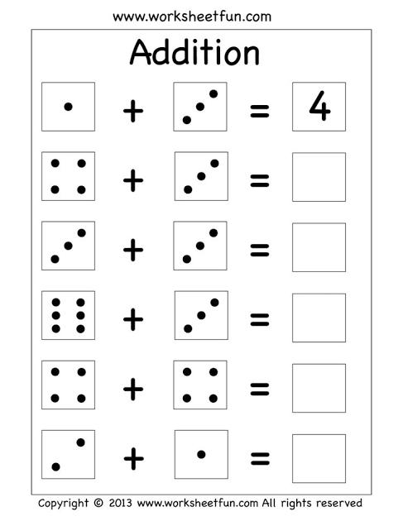
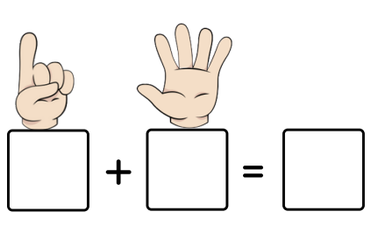
Module 4: Inclusiveness in all areas of education and training
6. Activity: Simple Addition Activity
FORM 6

Slide 19
Module 4: Inclusiveness in all areas of education and training
6. Activity: Simple Addition Activity
Additional Learning Sources:
Mutlu, Y. (2016). Mathematics learning disability (developmental dyscalculia). Theories in Mathematics Education. Ankara: Pegem Akademi
https://www.youtube.com/watch?v=7mvvj75holc

Slide 20
Module 4: Inclusiveness in all areas of education and training
7. Activity: Number Puzzle Activity
Learning Time: | 15-20 minutes
Content: | It is an important skill for children with dyscalculia to distinguish the shape differences of numbers. Especially colors can be used as an important tool for them to notice this difference. Form-7 is copied according to the number of students and distributed to all students. Students are given activity cards similar to the one in the picture in Form-7 and asked to write the numbers in the picture in the boxes according to their colors.

Slide 21
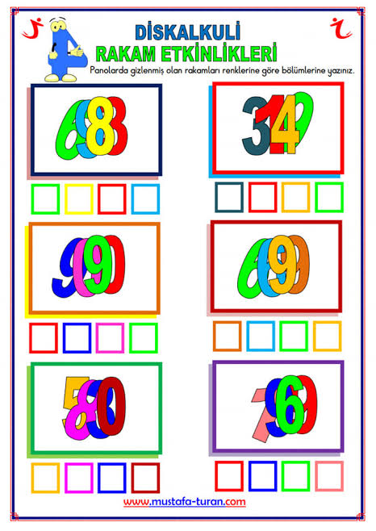
Module 4: Inclusiveness in all areas of education and training
7. Activity: Number Puzzle Activity
FORM 7

Slide 22
Module 4: Inclusiveness in all areas of education and training
7. Activity: Number Puzzle Activity
Additional Learning Sources:
Toptaş, Olkun, Çekirdekçi and Sarı (2020) Teaching Mathematics in Primary School, Vizetek Publications
https://www.youtube.com/watch?v=Gt75jzMzpSg

Slide 23
Module 4: Inclusiveness in all areas of education and training
8. Activity: Square Scribble Activity
Learning Time: | 15-20 minutes
Content: | It is very important to realize the relationship between object quantity and number expression in children with dyscalculia. For this purpose, in teaching numbers, students are asked to color in as many boxes as the number written in each section by preparing study cards as shown in the Form-8 picture.

Slide 24
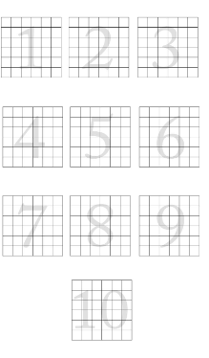
Module 4: Inclusiveness in all areas of education and training
8. Activity: Square Scribble Activity
FORM 8

Slide 25
Module 4: Inclusiveness in all areas of education and training
8. Activity: Square Scribble Activity
Additional Learning Sources:
Mutlu, Y. (2016). Mathematics learning disability (developmental dyscalculia). Theories in Mathematics Education. Ankara: Pegem Akademi.

Slide 26
Module 4: Inclusiveness in all areas of education and training
9. Activity: Finding the Right Direction Activity
Learning Time: | 15-20 minutes
Content: | Children with dyscalculia often encounter problems with writing and seeing the direction of numbers correctly. Especially the numbers 5, 2, 9, 6 and 7 are confused. Practicing to find the direction of numbers, as in the visuals in Form-9, Form-10 and Form 11, has obvious benefits in improving students' ability to perceive the direction of numbers correctly. The forms are copied according to the number of students and distributed to all students. Have students find the numbers facing the correct direction and circle them.

Slide 27
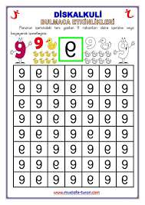
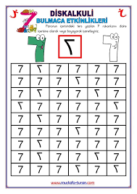
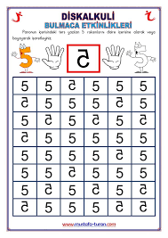
Module 4: Inclusiveness in all areas of education and training
9. Activity: Finding the Right Direction Activity
FORM 9
FORM 10
FORM 11

Slide 28
Module 4: Inclusiveness in all areas of education and training
9. Activity: Finding the Right Direction Activity
Additional Learning Sources:
Mutlu, Olkun, Akgün and Sarı (2020) Dyscalculia: Definition, Characteristics, Prevalence, Causes and Diagnosis of Mathematics Learning Disability, Pegem Academy
https://www.youtube.com/watch?v=_radX5wjaPE

Slide 29

Contact
Web: www.cu.edu.tr/eng/
Assoc. Prof. Dr. Oguzhan KIRDÖK
Head of Chair of Special Education
Faculty of Education
E-Mail: okirdok@cu.edu.tr

