Slide 1

Dyscalculia
WP2: Dyscalculia Curriculum and Course Material
Panevėžio „Žemynos“ progimnazija
Change Your Perspective: It´s Just Dyscalculia
Reference Number: 2022-1-TR01-KA220-SCH-000088738
Duration: 31.12.2022-30.12.2024 (24 months)
School Education ERASMUS+
KA220-SCH-Cooperation partnerschips in school education

Slide 2

Dyscalculia
Module 3: Teaching methods and techniques on the education of students with different learning levels
Panevėžio „Žemynos“ progimnazija
Change Your Perspective: It´s Just Dyscalculia
Reference Number: 2022-1-TR01-KA220-SCH-000088738
Duration: 31.12.2022-30.12.2024 (24 months)
School Education ERASMUS+
KA220-SCH-Cooperation partnerschips in school education

Slide 3
Module 3: Teaching methods and techniques on the education of students with different learning levels
Introduction of the Module
Content of the Module
Link to additional text
Link to additional videos
Quiz
Resources

Slide 4

Module 3: Teaching methods and techniques on the education of students with different learning levels
1. Introduction of the Module
“Module 3: E-learning” is about activities which could be useful to teach dyscalculic students. There will be an overview of teaching and professional skills needed and how to educate dyscalculic students. Methodological competences are presented in order to use different approaches and practices, activity examples, teaching methods and techniques for the education of students with different learning levels. Finally, the outline of how educators can develop their capacity in the long term will be given in Module 3.
https://pixabay.com/images/search/competence/

Slide 5

Module 3: Teaching methods and techniques on the education of students with different learning levels
2. Strategies helping to overcome dyscalculia
Special education teachers require skills to :
fulfil a range of duties specific to working in this field;
develop teaching plans for a variety of students with unique requirements;
change the school curriculum to reflect the requirements of individual students;
educate other teachers and parents on education techniques outside their lessons.
https://pixabay.com/photos/search/

Slide 6
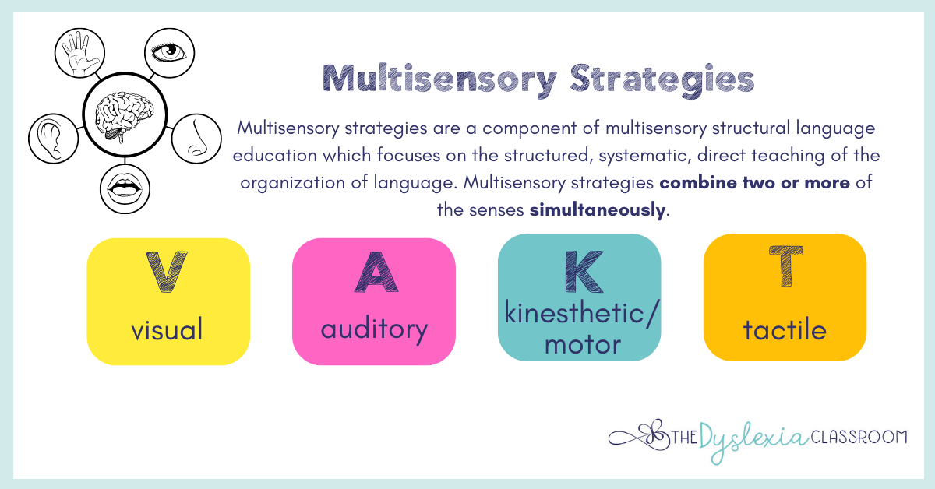
Module 3: Teaching methods and techniques on the education of students with different learning levels
2. Strategies helping to overcome dyscalculia
Teachers, who work with dyscalculic students, should use multi-sensory teaching techniques, which can be highly effective, because they involve using multiple senses (sight, hearing, touch, and movement) to help students learn and remember information.
https://www.thedyslexiaclassroom.com/blog/multi-sensory-instruction-moving-beyond-the-sand-tray

Slide 7

Module 3: Teaching methods and techniques on the education of students with different learning levels
2. Strategies helping to overcome dyscalculia
To help children with dyscalculia in terms of information processing or information processing speed in understanding a new skill quickly, teachers need to always give enough time or 'wait time'. It will help children with dyscalculia to process information effectively, especially a newly learned mathematical concept .
https://pixabay.com/photos/people-child-school-genius-316506/

Slide 8

Module 3: Teaching methods and techniques on the education of students with different learning levels
2. Strategies helping to overcome dyscalculia
Students with dyscalculia often have trouble remembering basic facts. So, mathematical operating procedures, drill techniques are effective to help retain information in understanding in their long-term memory.
https://pixabay.com/photos/search/remember%20information/

Slide 9

Module 3: Teaching methods and techniques on the education of students with different learning levels
2. Strategies helping to overcome dyscalculia
One of the main problem areas for children with dyscalculia is the recognition of numbers, mathematical signs or number symbols. The strength of children with dyscalculia is excellent visual thinking.
Art therapy is one of the best ways to solve the main problem of children with dyscalculia!

Slide 10
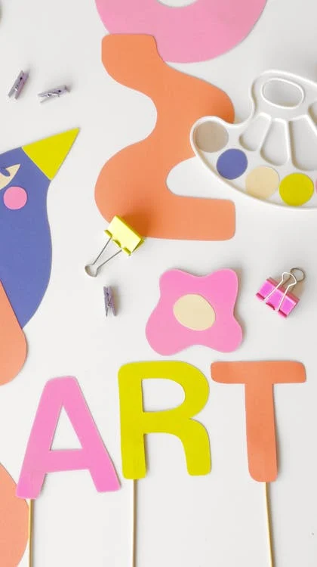
Module 3: Teaching methods and techniques on the education of students with different learning levels
2. Strategies helping to overcome dyscalculia
Creative methods should be used in teaching and learning process. Such as using:
- fingers or other means of calculation;
- natural materials: sandpaper or other textured paper;
- diagrams, draw mathematical concepts or tasks;
- colored pencils to separate tasks;
- rhythm and music, poems and stories to teach math concepts.
https://pixabay.com/photos/search/

Slide 11
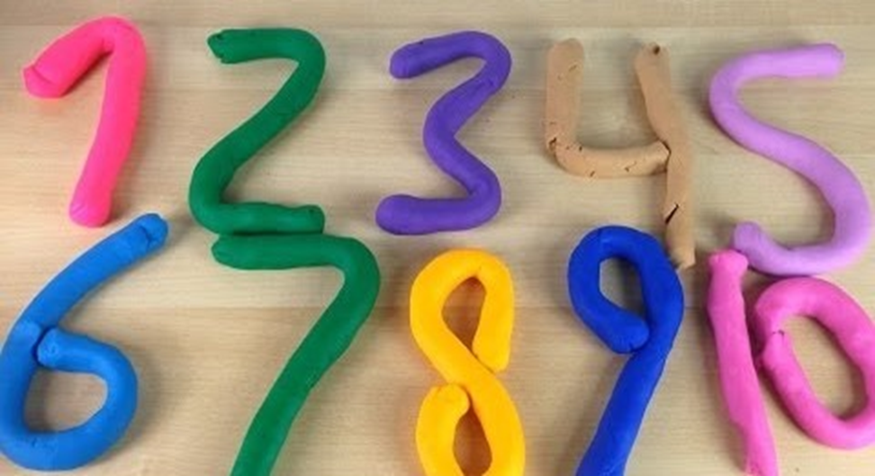
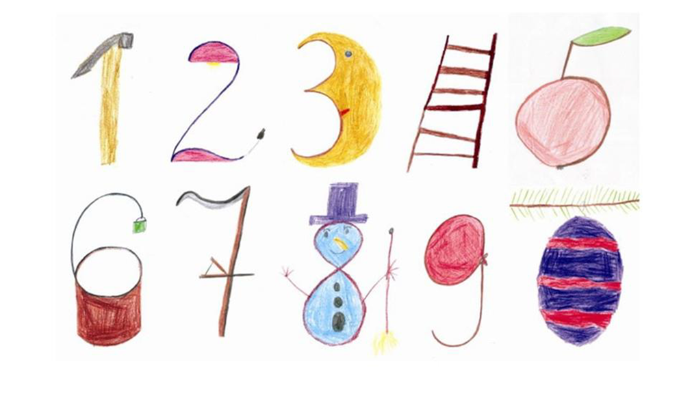
Module 3: Teaching methods and techniques on the education of students with different learning levels
3. Activities helping to overcome dyscalculia
Make the figures from plasticine
Draw pictures that resemble numbers.
http://kristianaweebly.weebly.com/uploads/1/8/5/2/18524958/sup_mokiniu_matematikos_mokymo_ypatumai.pdf
http://kristianaweebly.weebly.com/uploads/1/8/5/2/18524958/sup_mokiniu_matematikos_mokymo_ypatumai.pdf

Slide 12
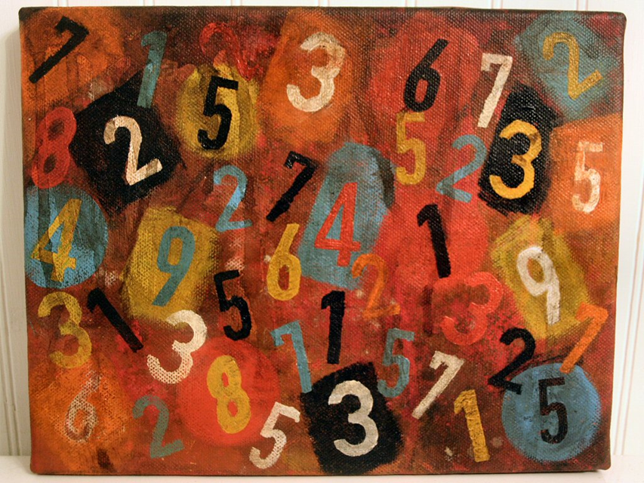
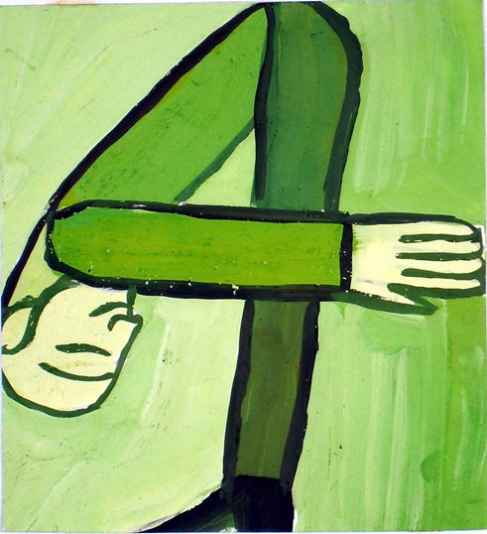
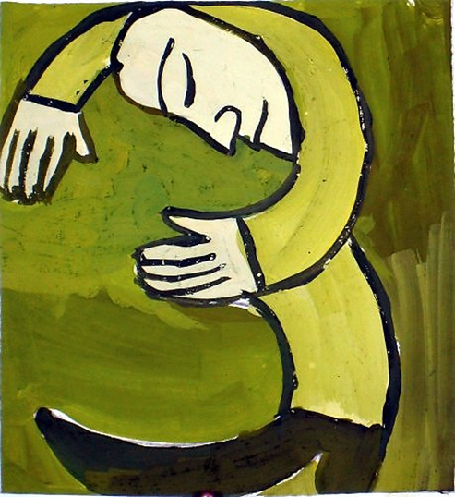
Module 3: Teaching methods and techniques on the education of students with different learning levels
3. Activities helping to overcome dyscalculia
Paint numbers that resemble people in different mood.
Find numbers from 0 to 10
http://kristianaweebly.weebly.com/uploads/1/8/5/2/18524958/sup_mokiniu_matematikos_mokymo_ypatumai.pdf
http://kristianaweebly.weebly.com/uploads/1/8/5/2/18524958/sup_mokiniu_matematikos_mokymo_ypatumai.pdf
http://kristianaweebly.weebly.com/uploads/1/8/5/2/18524958/sup_mokiniu_matematikos_mokymo_ypatumai.pdf

Slide 13
Module 3: Teaching methods and techniques on the education of students with different learning levels
3. Activities helping to overcome dyscalculia
Games for learning mathematics
An example of a mathematical fairy tale
In a large garden, under an old apple tree stump, lived strange colorful gnomes. There weren't many of them just eight. They all wore green hats and only a couple of dwarves had red shoes. The rest wore blue slippers with silver balls on the tip of the spike. There were three of them bearded and completely bald, and the rest wore ten strange braids on their little heads. They were all very fond of cherries, but they grew at the edge of the garden. They had to get up early, because until reached the edge of the garden, it took three hours, and you had to run 90 meters to reach the cherry tree. When they returned, they had breakfast and went to sleep a two hours , in the afternoon they loved to play dominoes. After finishing all the games, they went to take a nap at exactly 2 p.m. and got up at 2 a. m hours of rest. When they got up, they engaged in various activities: some rode a beetle, some climbed apple trees peak, some tidied up, some put the scattered clumps into neat baskets under five. In the evening, around 5 p.m., when everyone was already hungry, they gathered and baked pancakes from pollen and dew drops with lots of honey from bees. All of them were wrapped in burdock leaves, two for each dwarf. The gnomes day ended exactly at 8:00 p.m., when they fell asleep sweetly in yellow beds under an old apple tree stump
Possible questions:
How many dwarves didn't have red shoes? (6) How many dwarves wore blue slippers with silver balls on the tip? (6) How many dwarves wore strange coats? (5) How many braids were braided in total? (50) How many meters did the dwarves cover in an hour running to the cherry tree? (30 meters) When did the dwarves have breakfast? (12 o'clock) How many blocks will the gnomes need in total if they put six spiders five by one? (30)
How many total pancakes do the dwarves need to make for dinner? (16) How long is a dwarf day? (14 hours)

Slide 14



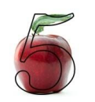
Module 3: Teaching methods and techniques on the education of students with different learning levels
3. Activities helping to overcome dyscalculia
In the middle of our garden, you can find a lot of berries. The cherry is hanging there beautifully. Isn't it a number..
It is round, soft and tied up with a string. It flies to the sky when you carry it. Isn't it a number..
When it is dark and it is scary to live without light. Turn on the lamp.
It looks like .....
Hey, prickly hedgehog,You are carrying a beautiful apple. After taking it off, take a look. An apple looks like ....

Slide 15

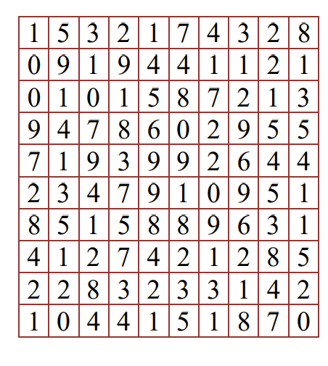
Module 3: Teaching methods and techniques on the education of students with different learning levels
3. Activities helping to overcome dyscalculia
The numbers written in the columns were hidden in the number maze. When you find them, colour them. Numbers are hidden in different directions:
15321 19240 10951 90847
82347 92228 97432 71254
79001 53231 98421 44629
28421 45318 53281 18780
74091 11520 25231 28609
98091 51870 93917 14794
12259 14401 96541 21714
The sum of the remaining numbers is 8
http://kristianaweebly.weebly.com/uploads/1/8/5/2/18524958/sup_mokiniu_matematikos_mokymo_ypatumai.pdf

Slide 16
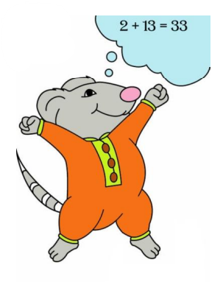
Module 3: Teaching methods and techniques on the education of students with different learning levels
3. Activities helping to overcome dyscalculia
The mouse could not count,
The mouse needed a machine!
Such as to take away
Such as to add
Such that count
He could for a mouse!
And the mouse got a machine -
But it's just a waste of time...
The mouse no longer knows
Where to put an inaccurate machine:
2 + 13 = 33
343 + 21 = 355
67 – 42 = 43
1862 – 461 = 1221
2350 + 2100 = 3550
6723 – 5101 = 1712
I can calm the mouse down
Because nothing terrible happened,
Because you need to have patience,
Just look at the task again:
The two numbers change there.
two numbers
Let's see - Two numbers!
Answer: 2 + 31 = 33; 334 + 21 = 355 ;67 – 24 = 43; 1862 – 641 = 1221 ; 2350 + 1200 = 3550 ; 6723 – 5011 = 1712
http://kristianaweebly.weebly.com/uploads/1/8/5/2/18524958/sup_mokiniu_matematikos_mokymo_ypatumai.pdf

Slide 17
Module 3: Teaching methods and techniques on the education of students with different learning levels
4. Link to additional text
“The Dyscalculia Assessment– A practical guide for teachers"
Authors: Jane Emerson and Patricia Babtie
Published in: Bloomsbury
Year: 2013
Link: https://books.google.lt/books?hl=lt&lr=&id=ww2aBQAAQBAJ&oi=fnd&pg=PP1&dq=methods+teaching+dyscalculia&ots=JYz9zhzLBY&sig=FiRZB6bsid00XuZce0oo4CxA7WE&redir_esc=y#v=onepage&q=methods%20teaching%20dyscalculia&f=false
„Dyslexia, Dyscalculia and Mathematics– A practical guide“
Authors: Anne Henderson
Published: London
Year: 2012
Link: https://books.google.lt/books?hl=lt&lr=&id=ggGxLtYQhfYC&oi=fnd&pg=PP2&dq=children+with+dyscalculia+teaching+programme&ots=wi0PbBtX4L&sig=qm80vy5kpDWnbho309__Z3vsMks&redir_esc=y#v=onepage&q=children%20with%20dyscalculia%20teaching%20programme&f=false

Slide 18
Module 3: E-learning
5. Link to additional videos
Link Video English: “Dyscalculia Teaching Strategies:
What is Dyscalculia?”
https://www.youtube.com/watch?v=etOT1uFcKTY

Slide 19
Module 3: Teaching methods and techniques on the education of students with different learning levels
6. Quiz
5. Quiz
Students with dyscalculia often have trouble:
remembering basic facts
remembering most important facts
no difficulties in remembering
Remembering their names
One of the main problem areas for children with dyscalculia is the recognition of :
numbers
mathematical signs
number symbols
numbers, mathematical signs or number symbols
One of the best ways to solve the main problem of children with dyscalculia:
art therapy
water therapy
no therapy
Lessons
To help children with dyscalculia in terms of information processing or information processing speed in understanding a new skill quickly teachers:
should always give enough time or 'wait time‘
should give extra homework
Shoud not pay attention to student

Slide 20
Module 3: Teaching methods and techniques on the education of students with different learning levels
7. Resources
Dyscalculia: What We Must Know about Students'Learning Disability in Mathematics? Universal Journal of Educational Research
8(12B): 8214-8222, 2020 http://www.hrpub.org DOI: 10.13189/ujer.2020.082625
https://dsf.net.au/learning-difficulties/dyscalculia/supporting-people-with-dyscalculia
https://teachercertification.com/dyscalculia-teaching-strategies/
https://www.brainbalancecenters.com/blog/strategies-for-managing-dyscalculia
https://www.tts-group.co.uk/blog/2017/07/09/practical-strategies-help-children-dyscalculia.html?gad_source=1&gclid=CjwKCAiA6KWvBhAREiwAFPZM7lX4ecdALxpunBUEcUSIDw3G1nwiT8C-IizEQ5TyJJyaLmyU0_RTMBoCbdkQAvD_BwE&gclsrc=aw.ds

Slide 21
Contact
https://x.com/TuhafAmaGercek/status/1790049439236690046?t=uG0azAFzBEsrudPxuUfRQA&s=08
Ramygalos99, Panevėžys, Lithuania
Vice –principal Kristina Žiedelienė
Primary school teacher Kristina Klimkevičienė
+37061281206
Ziedeliene@inbox.lt

