Slide 1

Dyscalculia
WP2: Dyscalculia Curriculum and Course Material
Çukurova
İlçe Milli Eğitim Müdürlüğü
Change Your Perspective: It´s Just Dyscalculia
Reference Number: 2022-1-TR01-KA220-SCH-000088738
Duration: 31.12.2022-30.12.2024 (24 months)
School Education ERASMUS+
KA220-SCH-Cooperation partnerschips in school education

Slide 2
Dyscalculia
Module 2: Dıagnosis Processes of Dyscalculic Individuals In Normal Education Enviroments
Çukurova
İlçe Milli Eğitim Müdürlüğü
Change Your Perspective: It´s Just Dyscalculia
Reference Number: 2022-1-TR01-KA220-SCH-000088738
Duration: 31.12.2022-30.12.2024 (24 months)
School Education ERASMUS+
KA220-SCH-Cooperation partnerschips in school education

Slide 3
In this module, diagnostic processes of dyscalculic individuals in normal education environments will be discussed. Information will be given about the professional skills that teachers should have in diagnostic processes.
Change Your Perspective: It´s Just Dyscalculia
Reference Number: 2022-1-TR01-KA220-SCH-000088738
Duration: 31.12.2022-30.12.2024 (24 months)
School Education ERASMUS+
KA220-SCH-Cooperation partnerschips in school education

Slide 4
Module 2: Diagnosis Processes of Dyscalculic Individuals In Normal Education Enviroments
Introduction of the Module
Content of the Module
Link to additional text
Link to additional videos
Quiz
Resources

Slide 5

Module 2: Diagnosis Processes of Dyscalculic Individuals In Normal Education Enviroments
1. Introduction of the Module
Navigating the educational landscape with a focus on inclusivity demands a nuanced understanding of learning differences like dyscalculia.
This modüle offers a concise overview of the systematic process involved in diagnosing dyscalculia in schools, underscoring the collaborative efforts of teachers, parents, and specialists. Following this, practical teaching methods and techniques are explored, emphasizing flexibility and individualization to cater to diverse learning levels within the dyscalculia spectrum. The objective is to equip educators with effective tools to create adaptive and inclusive learning environments, promoting the academic success of students with dyscalculia.
Source:

Slide 6
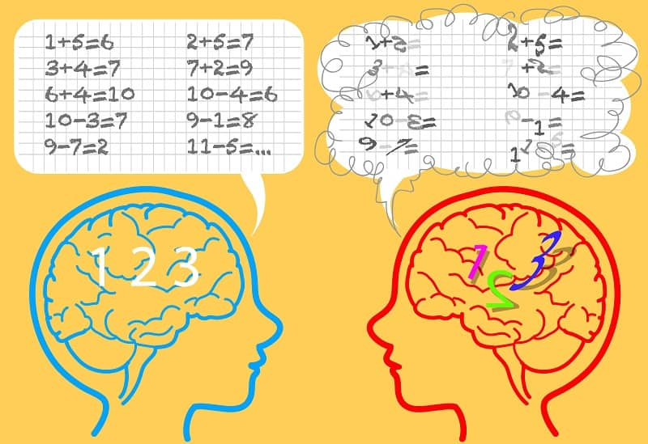
Module 2: Diagnosis Processes of Dyscalculic Individuals In Normal Education Enviroments
1. Introduction of the Module
Classroom teachers are often the initiators of the process of identifying students with specific learning disabilities. For this reason, classroom teachers have responsibilities such as discovering these students, directing them correctly and providing an educational environment for these students. teachers should take into account the performance of the student, identify his/her strengths and characteristics that need to be strengthened and prepare a plan accordingly. If, despite the teacher's best efforts and attention, there is no significant change in the student's performance, the student should be referred to the necessary persons and institutions for further investigation. However, it can be said that classroom teachers have both lack of knowledge and misconceptions in assessing difficulties (Kuruyer & Çakıroğlu, 2017). The most critical point for teachers here is to know whether the root cause of the difficulty is due to a disability, such as mental retardation or visual impairment. Distinguishing this is important for a clear diagnosis of specific learning disabilities. In order to answer this question, students must first have medical check-ups.
Source:

Slide 7
Module 2: Diagnosis Processes of Dyscalculic Individuals In Normal Education Enviroments
1. Introduction of the Module
Diagnosing dyscalculia in schools involves a structured approach comprising observation, assessment, and collaboration among educators, parents, and specialists. This process starts with identifying concerns through observation of a student's struggles with mathematical concepts. Initial screenings, incorporating standardized tests and teacher observations, help pinpoint students at risk. Valuable insights from teachers and parents contribute to a comprehensive understanding of the student's challenges.
A comprehensive assessment, typically conducted by a school psychologist or specialized professional, evaluates mathematical abilities and cognitive processing. This includes psychoeducational assessments to gauge overall cognitive functioning and math-specific assessments targeting strengths and weaknesses. Comparisons to developmental norms help identify significant gaps indicating dyscalculia.
Following assessment, collaborative intervention planning occurs, involving teachers, parents, and specialists. An individualized plan tailored to the student's needs is developed, with ongoing monitoring to evaluate progress and adjust support as necessary. Cultural considerations and ethical standards ensure a fair evaluation process. Professionals involved may include teachers, school psychologists, special education professionals, and other specialists, ensuring a holistic approach to supporting students with dyscalculia.

Slide 8
Module 2: Diagnosis Processes of Dyscalculic Individuals In Normal Education Enviroments
2. Content of the Module
Basic competencies that teachers should acquire in the diagnostic processes of dyscalculic individuals in regular education settings:
Know and apply diagnostic procedures
Know the tests, their content and purpose
Adapt the choice of diagnostic procedures according to the learning group

Slide 9
Module 2: Diagnosis Processes of Dyscalculic Individuals In Normal Education Enviroments
2. Content of the Module
Teachers' professional skills in identifying dyscalculic students should be increased.
Different learning levels according to individual differences are very important in diagnosing students.
It is quite normal for dyscalculic students to be present in classrooms, but they need to be recognized.
Teachers need to recognize dyscalculic students and, after identification, prepare appropriate educational environments and materials.
With the right diagnosis and individualized education planning, dyscalculic students will be able to learn.

Slide 10
Module 2: Diagnosis Processes of Dyscalculic Individuals In Normal Education Enviroments
2. Content of the Module
Module 2
The most important descriptive criteria that teachers should know for dyscalculic students are the following:
Inclusive Criteria
Have deficiencies in their ability to acquire mathematical knowledge and skills.
Have a persistent difficulty in learning number concepts, counting principles or arithmetic
Following their peers about 2 years behind.
Exclusionary Criteria
Mental retardation
Emotion disorder
Emotional disturbance
Socio-Cultural differences
Inadequate education

Slide 11
Module 2: Diagnosis Processes of Dyscalculic Individuals In Normal Education Enviroments
2. There are four important elements in defining dyscalculia
There are difficulties in understanding numbers or performing basic arithmetic operations that are inconsistent with the person's chronological age, educational opportunities or intellectual abilities.
The degree of difficulty is significant when assessed by standardized measures of these skills or persistent relative to academic performance.
There are significant barriers to academic achievements and daily life activities that require math skills.
Arithmetic difficulties occur at an early age and are not due to visual, hearing or neurological causes or lack of schooling.

Slide 12
Module 2: Diagnosis Processes of Dyscalculic Individuals In Normal Education Enviroments
2. Methods used in the diagnosis of dyscalculia
The methods commonly used in the diagnostic phase are the following:
Diagnostic methods by direct observation
Discrepancy method
Method of responding to intervention
Computer-based diagnostic tools
A new method: Multiple Filter Method
  In this method, individuals are observed and checklists prepared according to the symptoms of math learning disabilities are used to determine whether the individual has dyscalculia or not.
  It can be said that this method is inadequate because similar characteristics and symptoms can be seen in children without dyscalculia at certain ages or periods and it does not provide enough data on the reason for the child's low performance in mathematics.
  Diagnosing math learning disabilities by identifying the discrepancy between a child's intelligence and performance is one of the generally accepted methods.
  Criticisms of this method include that it may lead to reliability and validity problems, that it fails to distinguish between low-achieving children and those with mathematics learning difficulties, and that there are some dyscalculic students who do not show intelligence-achievement discrepancies.
  Response to intervention is a system of early identification and support for students at risk of academic failure and learning disabilities. This method is based on a student's low academic performance compared to their peers and inadequate performance with carefully planned instruction.
  However, the discrepancy/consistency method should still be used to identify math learning disabilities. Researchers recommend using this method in combination with the discrepancy/consistency method.
  Many computer-based dyscalculia diagnostic tools consist of similar mathematical and psychological tests.
  These tests included tasks such as comparing symbolic numbers based on the stroop and difference effects, canonical point counting based on the ability of sanbil, number line estimation, comparing non-symbolic multiplicities based on the weber fraction, comparing symbolic numbers, and mathematical four operations calculations.
  The Multiple Filter Model was designed in the light of the strengths and weaknesses of the diagnostic methods used to identify students with mathematics learning difficulties and the inclusion and exclusion criteria obtained from the definitions of dyscalculia.
  In this method, dyscalculia pre-assessment form, dyscalculia screening tool, student identification form and intelligence test are used as filters.

Slide 13
Module 2: Diagnosis Processes of Dyscalculic Individuals In Normal Education Enviroments
3. Link to additional text
http://dx.doi.org/10.6007/IJARPED/v6-i2/380
https://doi.org/10.17051/ilkonline.2017.330248
https://www.mathematicalbrain.com/pdf/Dyscalculia_Screener_Manual.PDF
English video: https://youtu.be/02MB3zI5iNI
Turkish video: https://www.youtube.com/live/5Hcnr5ZADd4?si=3bXBChKZbo96FJs4

Slide 14
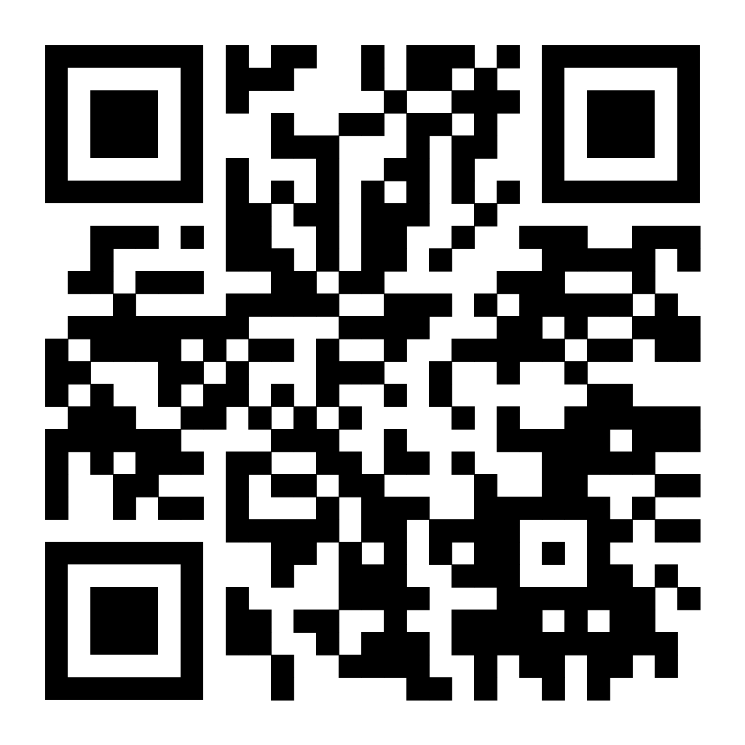
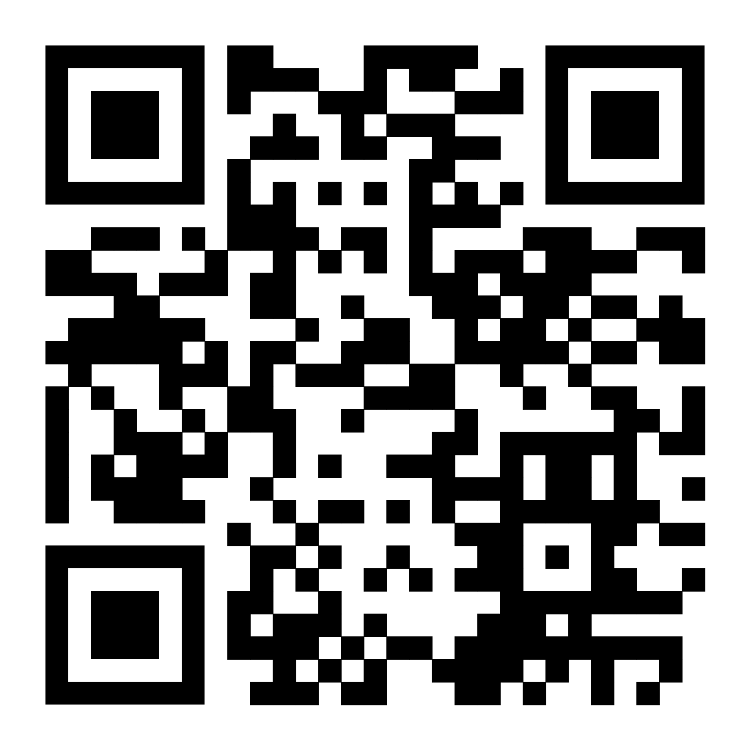
Module 2: Diagnosis Processes of Dyscalculic Individuals In Normal Education Enviroments
4. Link to additional videos
Link Video English: Facts and Myths about Dyscalculia
WP2-P0-Dyscalculia-Video-EN
Link Video partner language: Yılmaz Mutlu | Diskalkulik Öğrencilere Yönelik Öğretim Stratejileri ve Uygulamaları
WP2-P0-Dyscalculia-Video

Slide 15
Module 2: Diagnosis Processes of Dyscalculic Individuals In Normal Education Enviroments
5. Quiz
Question 1: What is the initial step in diagnosing dyscalculia in schools?
a) Comprehensive Assessment
b) Psychoeducational Assessment
c) Observation and Concern Identification
d) Parental Input
Question 2: Which assessment is conducted to evaluate a student's overall cognitive functioning, including areas such as working memory, attention, and processing speed?
a) Math-specific Assessment
b) Psychoeducational Assessment
c) Comparison to Developmental Norms
d) Initial Screening
Question 3: What is a recommended technique for teaching students with dyscalculia involving real-world applications?
a) Multi-Sensory Approaches
b) Visual Representations
c) Real-World Applications
d) Repetition and Reinforcement
Question 4: Which teaching method emphasizes breaking down complex mathematical concepts into smaller, manageable steps?
a) Differentiated Instruction
b) Personalized Learning Plans
c) Structured and Sequential Learning
d) Positive Reinforcement

Slide 16
6. Resources
Koç, B. (2018). Diskalkulik öğrencilere toplama ve çıkarma öğretimine yönelik bir eylem araştırması (Doctoral dissertation, Necmettin Erbakan University (Turkey)).
Butterworth, B. (2005). Developmental dyscalculia. In The handbook of mathematical cognition (pp. 455-467). Psychology Press.
Fu, S. H., & Chin, K. E. (2017). An online survey research regarding awareness of dyscalculia among educators in Sandakan district, Sabah. International Journal of Academic Research in Progressive Education and Development, 6(2), 1-10.

Slide 17
Contact
100. Yıl Mahallesi, 85183. Sk. No:4,
01170 Çukurova/Adana
Web: https://cukurova.meb.gov.tr/
Ayşe KARAKILIC
Project Coordinatör
Çukurova İlçe Milli Eğitim Müdürlüğü
Telephone +905072336660
E-Mail agurgah@hotmail.com
Rezzan GIZIR
Project Coordinatör
Çukurova İlçe Milli Eğitim Müdürlüğü
Telephone +905072336660
E-Mail rezzanbalcilar@gmail.com

